Slide 1

Cyber security in

Slide 2

FIRST IoT DEVICE!
1980s, David Nichols, a graduate student in Carnegie Mellon University’s computer science department, was in his office on campus at Wean Hall craving a soda.

Slide 3
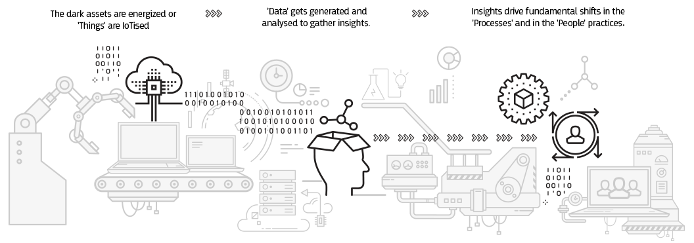
WHAT IS THE NEED OF IOT?

Slide 4
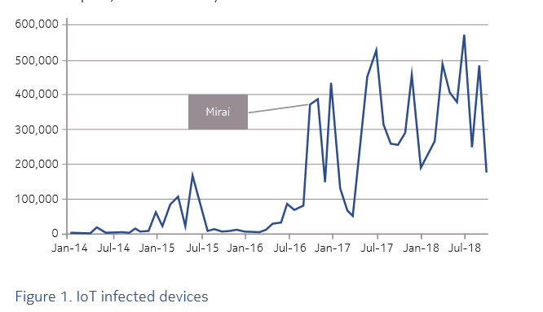
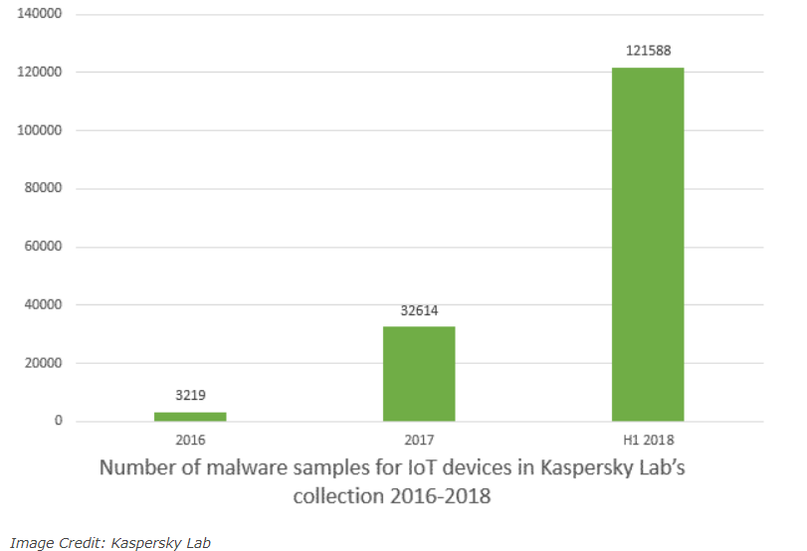
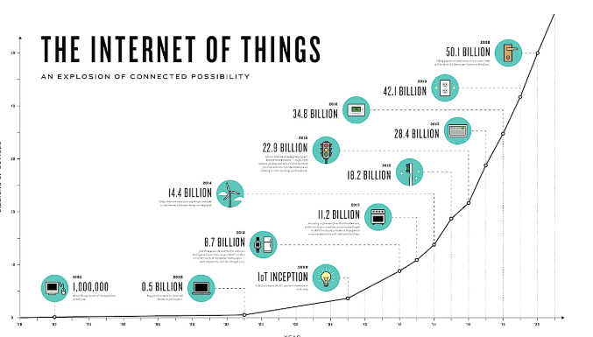
INTERNET OF THINGS

Slide 5

INTEGRATION AND LEGACY SYSTEMS

Slide 6
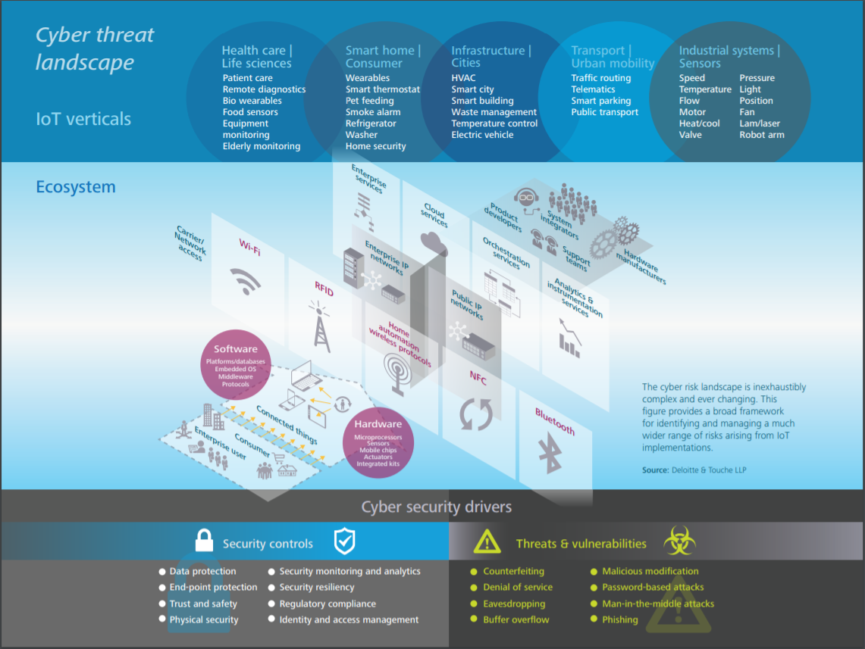

Slide 7
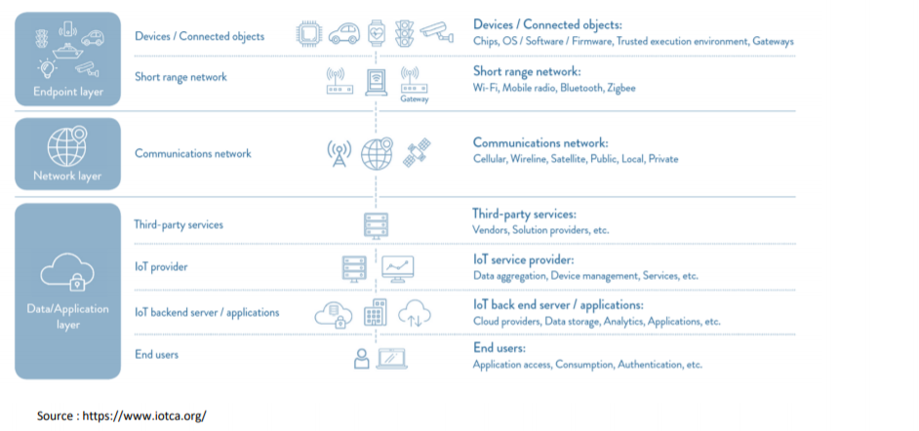
LAYERS IN IOT STRUCTURE

Slide 8
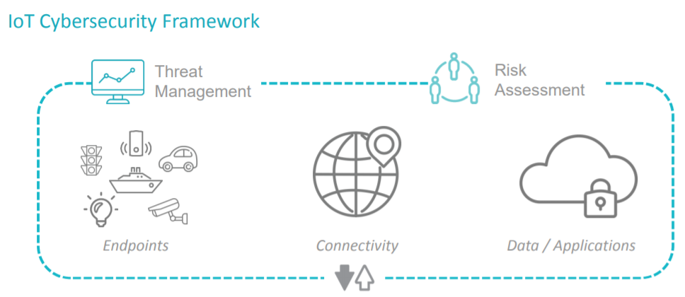

Slide 9
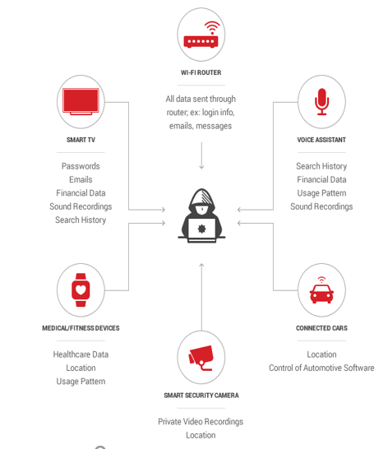
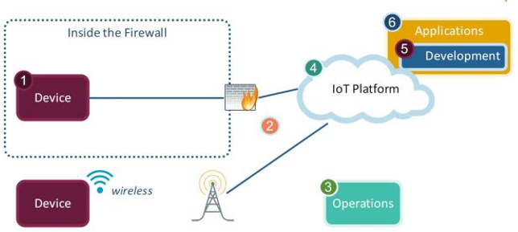
Category of Attacks in IOT
DEVICE ATTACK:

Slide 10

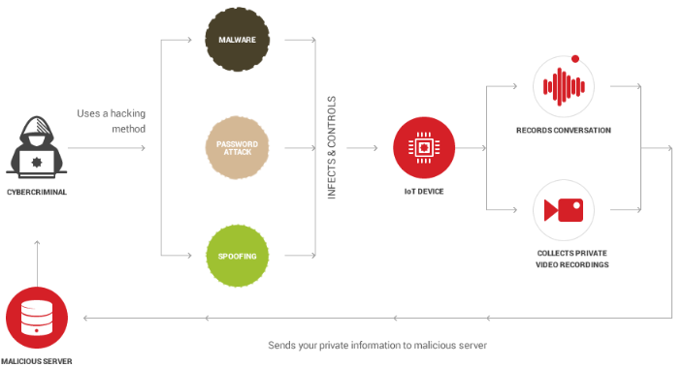
DATA ATTACK PRIVACY ATTACK

Slide 11
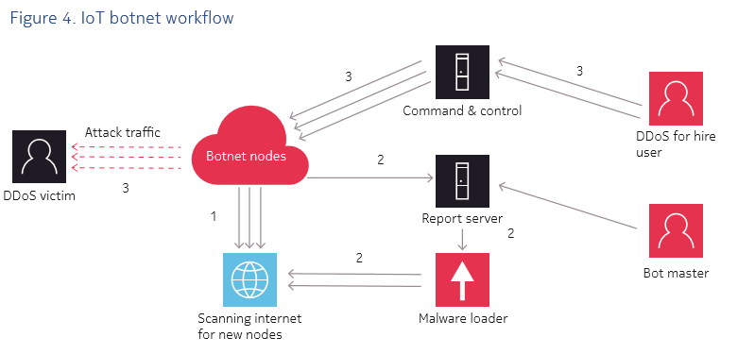
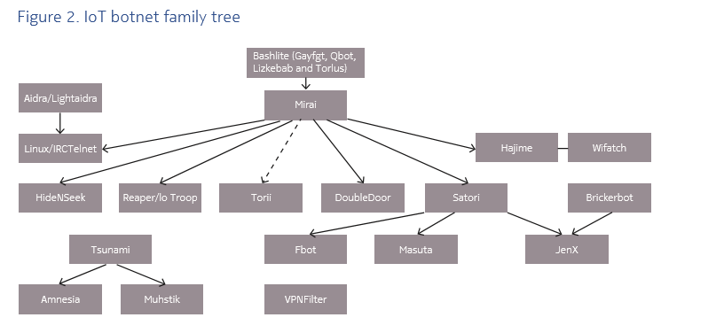
Network Availability Attack
There have been three main areas of evolutionary change:
• How the bot spreads
• What the bot is used for
• How the bot communicates with its command control

Slide 12

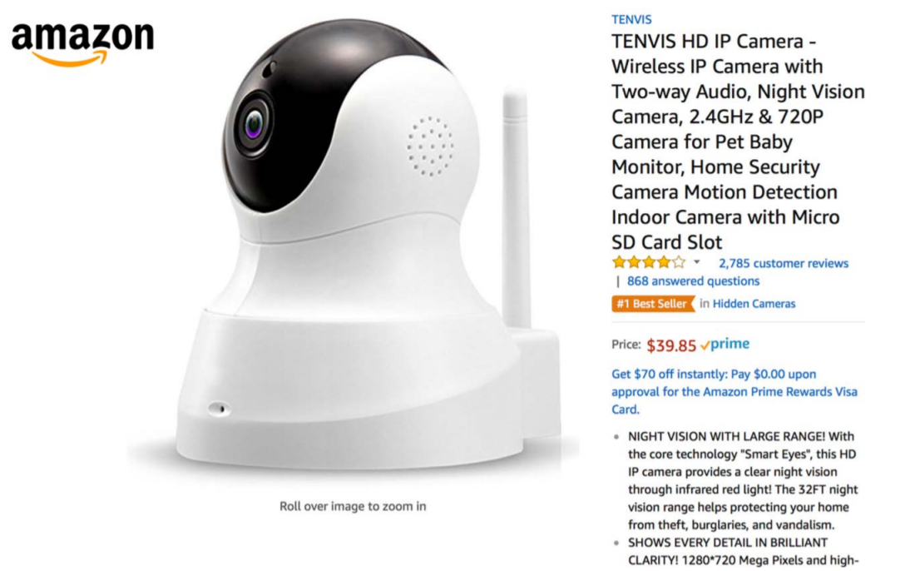
RECENT ATTACKS!
Kangaroo!
WIFI ENABLED CAMERA!

Slide 13
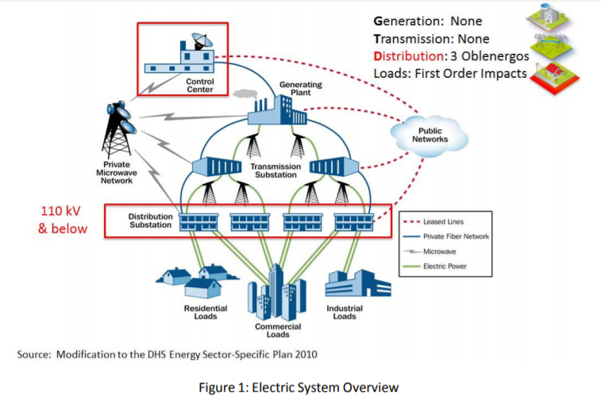
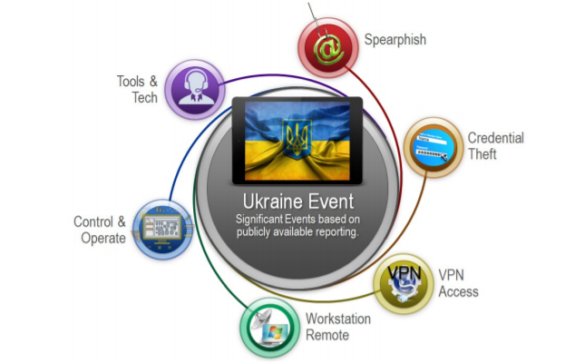
UKRAINE POWER GRID HACKING
UK Electric Grid Attack
Spear Fishing Attack
supervisory control and data acquisition using Black Energy Malware.

Slide 14
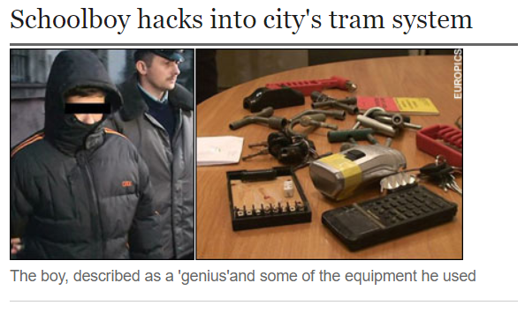
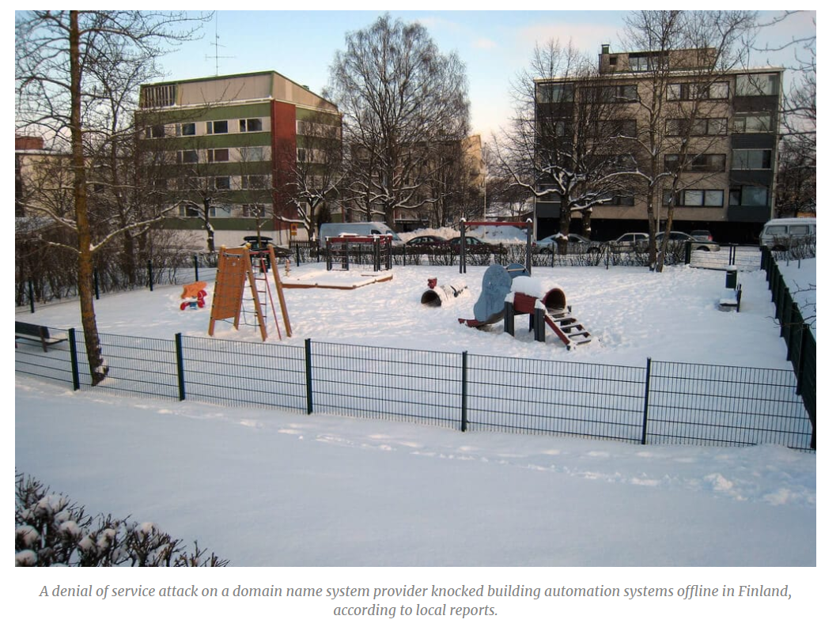
Tram Hack Lodz, Poland
Smart building Attack in Finland
This was the first cyber Kinetic attack which resulted in Human injuries

Slide 15
MITIGATION OF ATTACKS!
Access Control
Encryption
Authentication
Regular Security Patches and updates
Physical Security
Intrusion detection system
IP Fast hopping
This is an effective layer on the network which hides the real IP address which can prevent the identification of destination of the network traffic.

Slide 16
QUESTIONS?
References:
https://www.ey.com/Publication/vwLUAssets/EY-cybersecurity-and-the-internet-of-things/%24FILE/EY-cybersecurity-and-the-internet-of-things.pdf
https://www.blueboltsolutions.com/the-impact-of-internet-of-things-iot-on-cybersecurity-2.aspx
J. Wan, M. Chen, F. Xia, D. Li, and K. Zhou, From Machine-to-machine communications towards cyber-physical systems Computer Science and Information Systems (ComSIS), vol. 10, no. 3, pp. 1105–1128, 2013. doi:10.2298/CSIS120326018W.
B. Miller and D.C. Rowe, A survey of SCADA and critical infrastructure incidents in Proceedings of the First Annual Conference on Research in Information Technology, Calgary, 2012. doi:10.1145/2380790.2380805.
https://www.cisco.com/c/dam/en_us/solutions/trends/iot/docs/security-risks.pdf
R.M. Lee, M.J. Assante and T. Conway, Analysis of the Cyber Attack on the Ukrainian Power Grid Electricity Information Sharing and Analysis Center (E - ISAC), 2016.
X. Li, X. Liang, R. Lu, X. Shen, X. Lin and H. Zhu, Securing smart grid: cyber attacks, countermeasures, and challenges IEEE Communications Magazine, vol. 50, no. 8, pp. 38–45, 2012.
S. Mishra, X. Li, A. Kuhnle, M.T. Thai and J. Seo, Rate alteration attacks in smart grid in Proceedings of the 2015 IEEE Conference on Computer Communications (INFOCOM)

